Slide 1
Web Concept
By Vivek Gohil

Slide 2
Content
Web Servers
HTTP
HTTP Request
HTTP Response
HTTP Session

Slide 3
Web Server
The term web server can refer to hardware or software, or both of them working together.
On the hardware side, a web server is a computer that stores web server software and a website's component files.
On the software side, a web server includes several parts that control how web users access hosted files.
At a minimum, this is an HTTP server. An HTTP server is software that understands URLs (web addresses) and HTTP (the protocol your browser uses to view webpages).

Slide 4
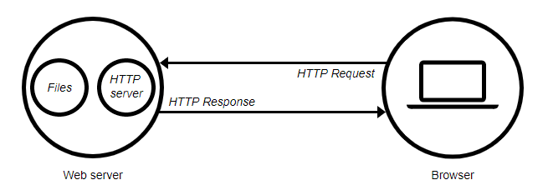
Web Server
At the most basic level, whenever a browser needs a file that is hosted on a web server, the browser requests the file via HTTP.
When the request reaches the correct (hardware) web server, the (software) HTTP server accepts the request, finds the requested document, and sends it back to the browser, also through HTTP.

Slide 5
Web Server
To publish a website, you need either a static or a dynamic web server.
A static web server, or stack, consists of a computer (hardware) with an HTTP server (software). We call it "static" because the server sends its hosted files as-is to your browser.
A dynamic web server consists of a static web server plus extra software, most commonly an application server and a database. We call it "dynamic" because the application server updates the hosted files before sending content to your browser via the HTTP server.

Slide 6
An overview of HTTP
HTTP is a protocol which allows the fetching of resources, such as HTML documents.
It is the foundation of any data exchange on the Web and it is a client-server protocol, which means requests are initiated by the recipient, usually the Web browser.
A complete document is reconstructed from the different sub-documents fetched, for instance text, layout description, images, videos, scripts, and more.

Slide 7
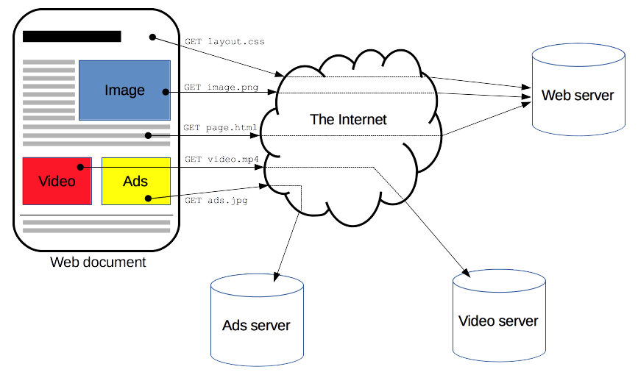
An overview of HTTP

Slide 8
Stateless and Stateful Protocol
Network Protocols for web browser and servers are categorized into two types.
Stateless Protocol
Stateful Protocol

Slide 9
Stateless Protocol
Stateless Protocols are the type of network protocols in which Client send request to the server and server response back according to current state.
It does not require the server to retain a status about each communicating partner for multiple request.
Example of Stateless Protocol
HTTP (Hypertext Transfer Protocol)
UDP (User Datagram Protocol)
DNS (Domain Name System)

Slide 10
Stateful Protocol
In Stateful Protocol If client send a request to the server then it expects some kind of response, if it does not get any response then it resend the request.
Example of Stateful Protocol
FTP (File Transfer Protocol)
Telnet

Slide 11
HTTP Request and HTTP Response
An HTTP client sends an HTTP request to a server in the form of a request message which includes following format:
A Request-line
Zero or more header (General|Request|Entity) fields followed by CRLF
An empty line (i.e., a line with nothing preceding the CRLF) indicating the end of the header fields
Optionally a message-body

Slide 12
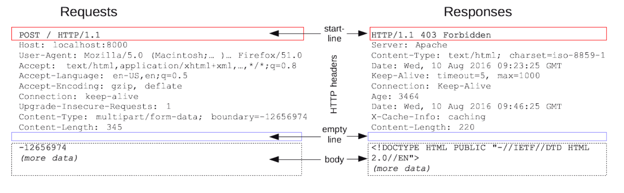
HTTP Request and HTTP Response

Slide 13
Request Header
A request header is an HTTP header that can be used in an HTTP request to provide information about the request context, so that the server can tailor the response.
Host
User-Agent
Accept
Accept-Language
Accept-Encoding
Connection
Upgrade-Insecure-Request
Content-Type
Content-Length

Slide 14
Response Header
A response header is an HTTP header that can be used in an HTTP response and that doesn't relate to the content of the message.
Server
Content-Type
Date
Keep-Alive
Connection
Age
X-Cache Info
Content Length

Slide 15
HTTP Data Transfer Formats
Query Parameters
Form Parameters
Multi part
Raw

Slide 16
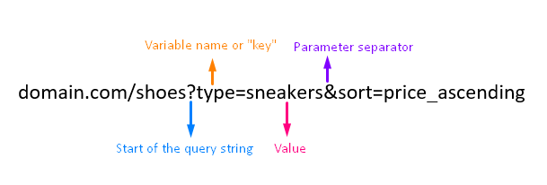
Query Parameters – Form Parameters
Question Mark: This starts the URL parameter
Ampersand: This separates parameters when you have multiple in one URL
Variable Name: (or "key") is like the title or label of the parameter
Value: This is the specific value that the key identifies

Slide 17
Multi part
multipart/form-data is one of the value of enctype attribute, which is used in form element that have a file upload. multi-part means form data divides into multiple parts and send to server.

Slide 18
Raw
If you want to send simple text/ ASCII data, then x-www-form-urlencoded will work. This is the default. But if you have to send non-ASCII text or large binary data, the form-data is for that.

Slide 19
HTTP Response Status Code
HTTP response status codes indicate whether a specific HTTP request has been successfully completed. Responses are grouped in five classes:
Informational responses (100–199)
Successful responses (200–299)
Redirects (300–399)
Client errors (400–499)
Server errors (500–599)
Read more on : https://developer.mozilla.org/en-US/docs/Web/HTTP/Status

Slide 20
Cookies
Cookies are text files with small pieces of data — like a username and password — that are used to identify your computer as you use a computer network.
Browser cookies are identified and read by “name-value” pairs. These tell cookies where to be sent and what data to recall.

Slide 21
HTTP Session and Session ID
A session ID is a unique number that a Web site's server assigns a specific user for the duration of that user's visit (session).
Every time an Internet user visits a specific Web site, a new session ID is assigned. Closing a browser and then reopening and visiting the site again generates a new session ID.

